Slide 1
Naïve Bayes Classifier

Slide 2
Things We’d Like to Do
Spam Classification
  Given an email, predict whether it is spam or not
Medical Diagnosis
  Given a list of symptoms, predict whether a patient has disease X or not
Weather
  Based on temperature, humidity, etc… predict if it will rain tomorrow

Slide 3
Generative vs. Discriminative Classifiers
Training classifiers involves estimating f: X → Y, or P(Y|X)
Discriminative classifiers (also called ‘informative’ by Rubinstein&Hastie):
Assume some functional form for P(Y|X)
Estimate parameters of P(Y|X) directly from training data
Generative classifiers
Assume some functional form for P(X|Y), P(X)
Estimate parameters of P(X|Y), P(X) directly from training data
Use Bayes rule to calculate P(Y|X= x_{i})

Slide 4
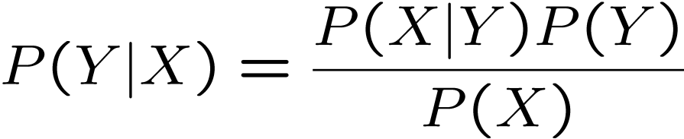
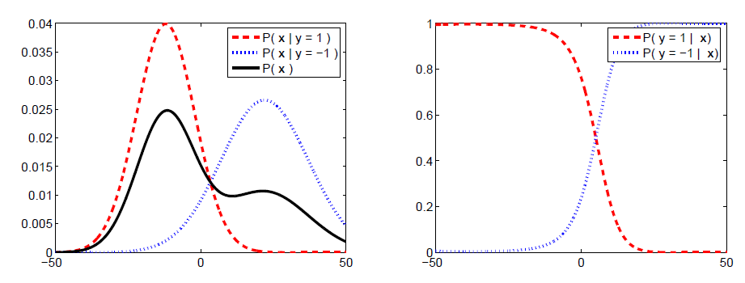
Bayes Formula

Slide 5
Discriminative Model vs Generative models
In simple words, a discriminative model makes predictions based on conditional probability and is either used for classification or regression.
On the other hand, a generative model revolves around the distribution of a dataset to return a probability for a given example.

Slide 6
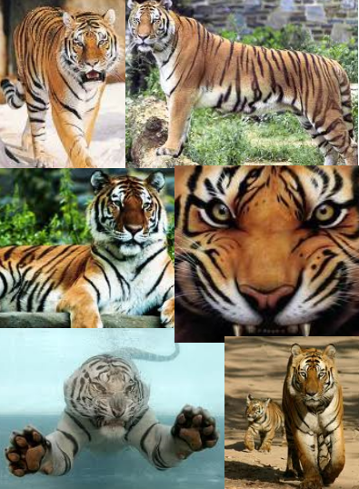

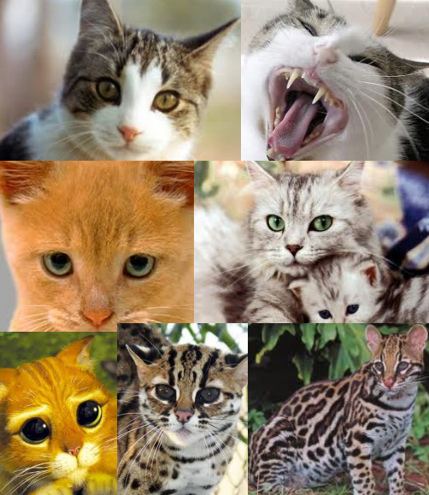
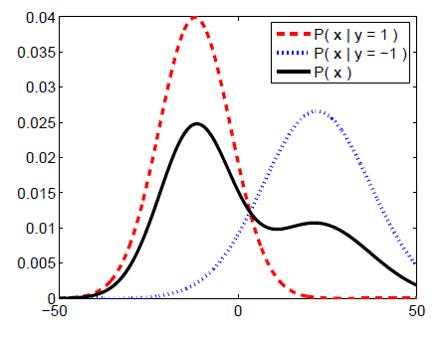
Generative Model
Color
Size
Texture
Weight
…

Slide 7
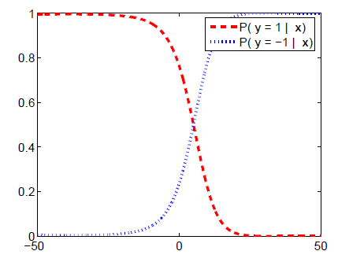
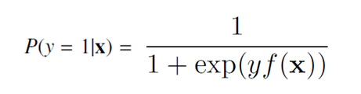
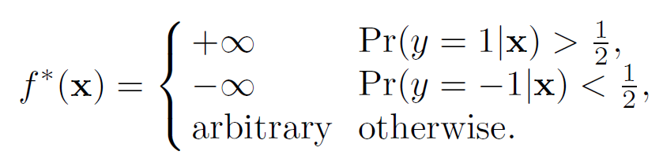
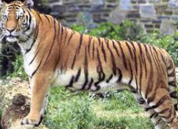

Discriminative Model
Logistic Regression
Color
Size
Texture
Weight
…

Slide 8
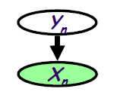
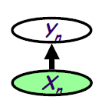
Comparison
Generative models
  Assume some functional form for P(X|Y), P(Y)
  Estimate parameters of P(X|Y), P(Y) directly from training data
  Use Bayes rule to calculate P(Y|X= x)
Discriminative models
  Directly assume some functional form for P(Y|X)
  Estimate parameters of P(Y|X) directly from training data

Slide 9
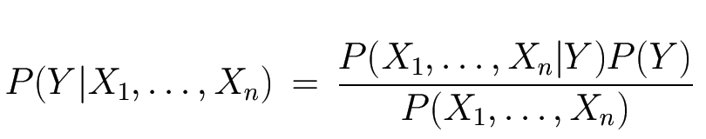
The Bayes Classifier
Use Bayes Rule!
Why did this help? Well, we think that we might be able to specify how features are “generated” by the class label
Likelihood
Prior
Normalization Constant

Slide 10








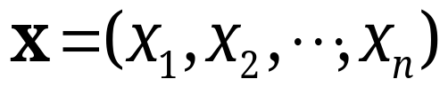
Probabilistic Classification
Establishing a probabilistic model for classification
  Discriminative model
Discriminative
Probabilistic Classifier

Slide 11





Probabilistic Classification
Establishing a probabilistic model for classification (cont.)
  Generative model
Generative
Probabilistic Model
for Class 1
Generative
Probabilistic Model
for Class 2
Generative
Probabilistic Model
for Class L

Slide 12
Conclusions
Naïve Bayes is:
  Really easy to implement and often works well
  Often a good first thing to try
  Commonly used as a “punching bag” for smarter algorithms

Slide 13
Naïve Bayes (4)
Problems
  Features may overlapped
  Features may not be independent
    Size and weight of tiger
  Use a joint distribution estimation (P(X|Y), P(Y)) to solve a conditional problem (P(Y|X= x))
Can we discriminatively train?
  Logistic regression
  Regularization
  Gradient ascent

Slide 14
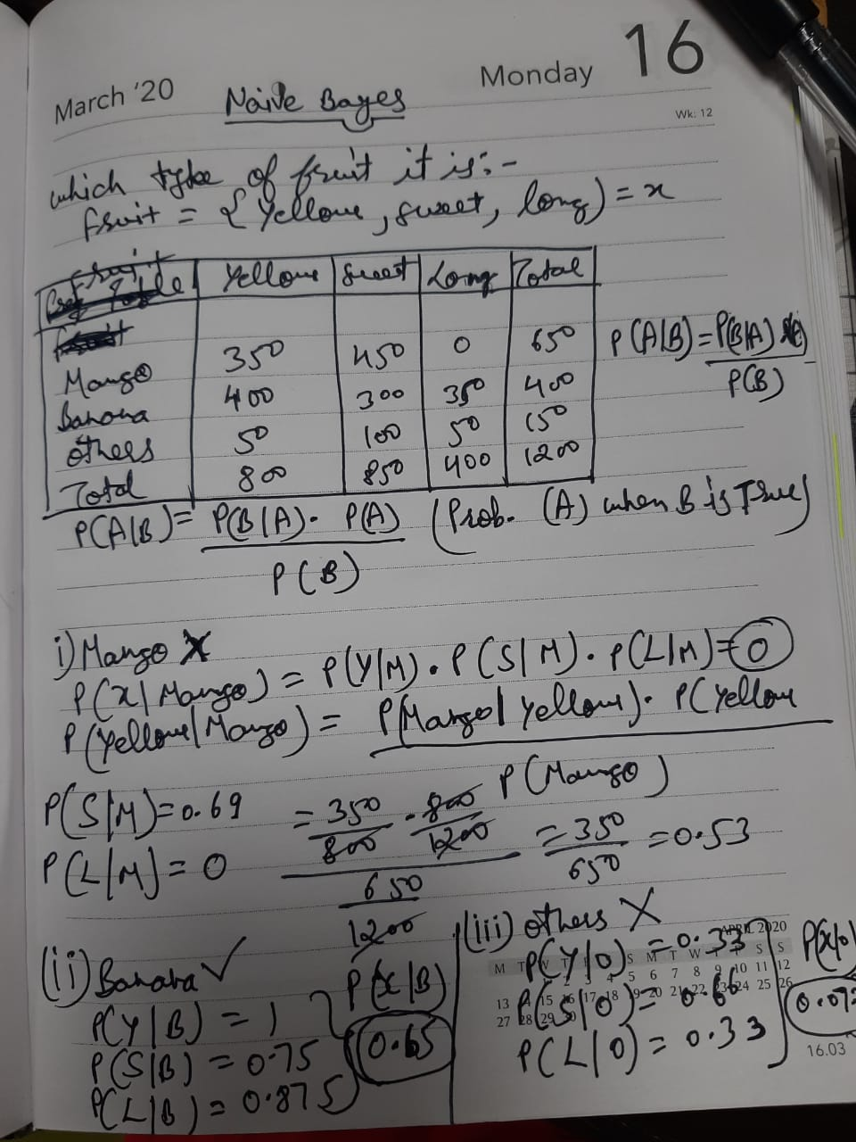

Slide 15
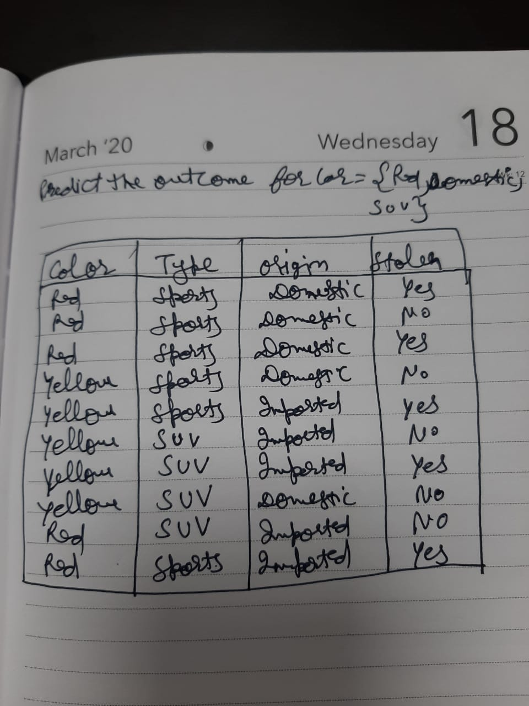

Slide 16

Example
Example: Play Tennis

Slide 17
Example
Learning Phase
Outlook | Play=Yes | Play=No
Sunny | 2/9 | 3/5
Overcast | 4/9 | 0/5
Rain | 3/9 | 2/5
Temperature | Play=Yes | Play=No
Hot | 2/9 | 2/5
Mild | 4/9 | 2/5
Cool | 3/9 | 1/5
Humidity | Play=Yes | Play=No
High | 3/9 | 4/5
Normal | 6/9 | 1/5
Wind | Play=Yes | Play=No
Strong | 3/9 | 3/5
Weak | 6/9 | 2/5
P(Play=Yes) = 9/14
P(Play=No) = 5/14

Slide 18
Example
Test Phase
  Given a new instance,
  x’=(Outlook=Sunny, Temperature=Cool, Humidity=High, Wind=Strong)
  Look up tables
  MAP rule
P(Outlook=Sunny|Play=Yes) = 2/9
P(Temperature=Cool|Play=Yes) = 3/9
P(Humidity=High|Play=Yes) = 3/9
P(Wind=Strong|Play=Yes) = 3/9
P(Play=Yes) = 9/14
P(Outlook=Sunny|Play=No) = 3/5
P(Temperature=Cool|Play==No) = 1/5
P(Humidity=High|Play=No) = 4/5
P(Wind=Strong|Play=No) = 3/5
P(Play=No) = 5/14
P(Yes|x’): [P(Sunny|Yes)P(Cool|Yes)P(High|Yes)P(Strong|Yes)]P(Play=Yes) = 0.0053
P(No|x’): [P(Sunny|No) P(Cool|No)P(High|No)P(Strong|No)]P(Play=No) = 0.0206
Given the fact P(Yes|x’) < P(No|x’), we label x’ to be “No”.

